Slide 1
User-driven constraint modeling for Entity models at runtime
Anton Skripin
Chair of Software Technology
Institute of Software and Multimedia Technology
Master’s Thesis Defence
First reviewer: Prof. Dr. rer. nat. Uwe Aßmann Second reviewer: Dr.-Ing. Sebastian Götz Supervisor: M. Sc. Karl Kegel
Dresden, 27.04.2023

Slide 2
Outline
Objectives and motivation
System requirements
Related work
Solution concept
Evaluation
Future work

Slide 3
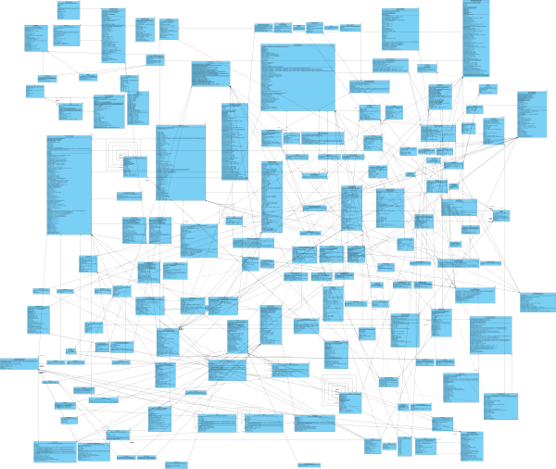
Introduction
Modern software products comprise several artifacts backed up by models
Models play an integral part in modern software
However, they are not expressive enough to catch all domain requirements in a highly-dynamic domain
How can we deal with it?
By creating and validating constraints on entity class diagrams

Slide 4
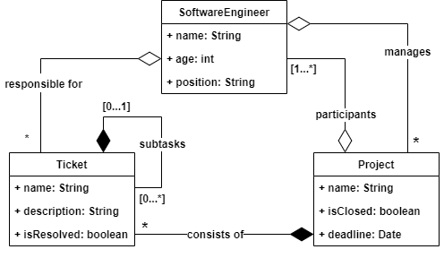
Introduction
Can a software engineer manage a closed project?
Problem: The entity model is unrestricted and might not fulfill any potential requirements

Slide 5
Introduction
Can a software engineer manage a closed project?
Context: Software engineer
inv: self.manages ->
forAll (project | project.isClosed = false)
Requirement: Any engineer must work on open projects
Solution: Applying constraints ensures that a domain behaves within allowed boundaries
However…
Standard constraint definition tools lack runtime environment
Constraint creation happens at compile time before deployment

Slide 6
Motivation
To reflect any kind of requirements in a domain, one can enrich the entity class diagram with dynamic constraints adapting to a context
If end-users are allowed to tune the domain of an application via constraints, the following questions arise:
What abstraction for constraint definition would be appropriate for users?
How can one use constraints on a model that might change at any time?
What is the right balance between complexity and expressiveness for end-users?

Slide 7
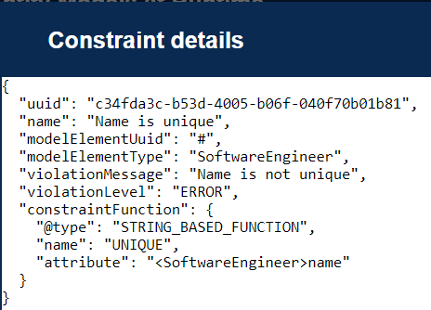
Objective
Goal: Close the research gap between the power of constraint modeling languages and their applicability in the context of variant-aware models at runtime
Steps:
Research the usage of constraints by end-users on entity models at runtime
Analyze state-of-the-art constraint languages and modeling techniques to be applied at runtime
Design technology-agnostic specification of a constraint modeling tool
Implement the defined specification using concrete constraint technologies
Evaluate and compare them in a case-study
Result: Framework oriented on end-users to constrain entity models at runtime with constraint integrity mechanisms

Slide 8
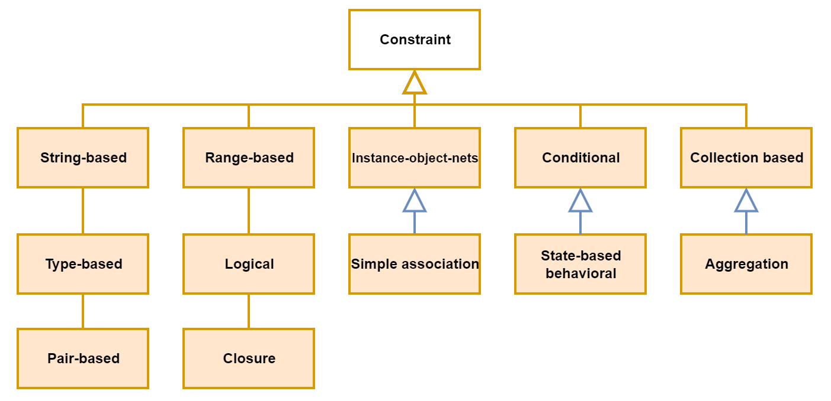
Requirements Classification of constraint types

Slide 9
Requirements Constraint definition, life cycle, integrity mechanisms?
Q1: At what level of modeling should constraints be defined and evaluated?
Q2: What elements and actions should comprise a constraint life cycle?
Q3: How do instance-related changes affect the integrity of constraints and how to keep them up to date in the presence of changes?
Q4: How do model-related changes affect the integrity of constraints, and what measures should be taken to guarantee model constraint correctness?

Slide 10
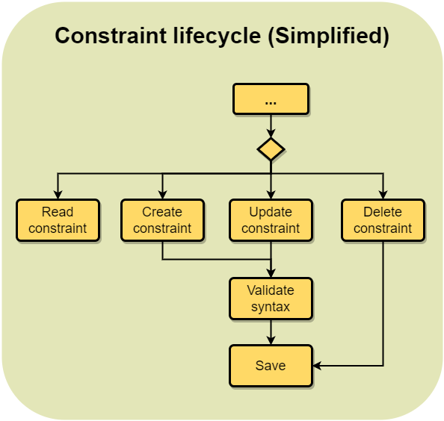
Requirements Constraint lifecycle
Four basic operations:
Create
Read
Update
Delete
Constraint syntax is validated upon update or create

Slide 11
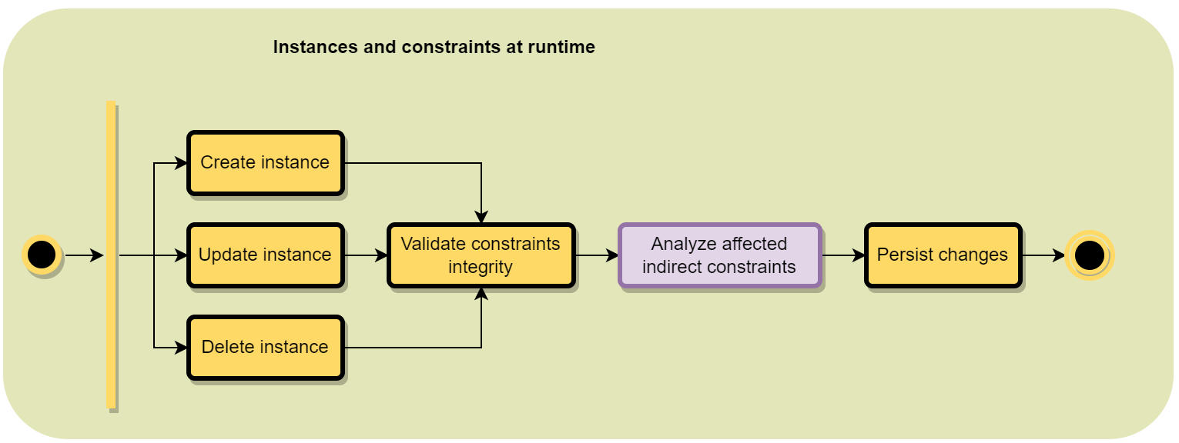
Requirements Model instances and constraints at runtime
Pass an event to the constraint framework upon an instance-related operation
The framework validates constraints for each instance in a subgraph
If a constraint spans several instances, indirect constraints must also be analyzed
Provide feedback to an end-user

Slide 12
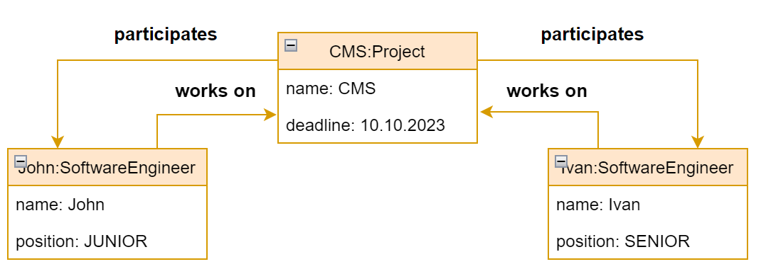
Requirements …analyze affected indirect constraints
Constraint:
Context: Project
Body: At least two software engineers must work on the CMS project (VALID)

Slide 13


Requirements …analyze affected indirect constraints
Constraint:
Context: Project
Body: At least two software engineers must work on the CMS project (INVALID)

Slide 14
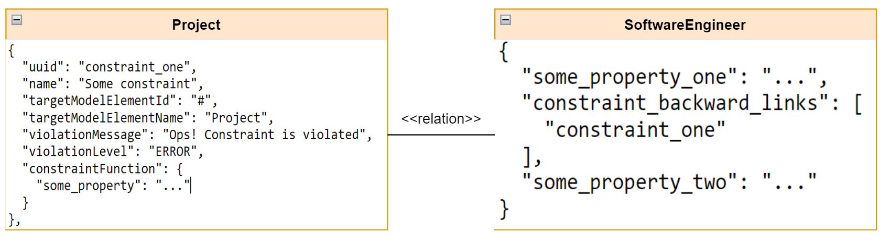
Requirements …analyze affected indirect constraints
Constraint:
Context: Project
Body: At least two software engineers must work on the CMS project
Backward links implication: Changes in “SoftwareEngineer” instances will trigger the evaluation of “constraint_one” since “SoftwareEngineer” has a backward compatible link to “Project”.

Slide 15
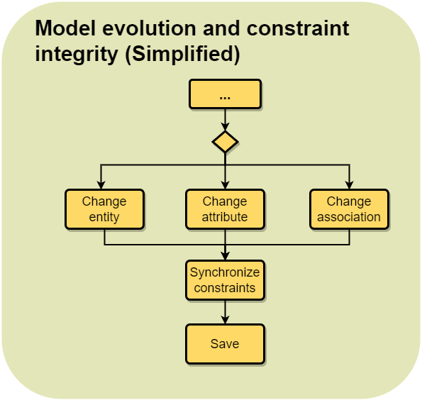
Requirements Model evolution and constraints at runtime
Evolution of a domain model might break some constraints
Before persisting any changes regarding a model element, the client software must first call the constraint framework for one of two purposes:
To correct affected constraints automatically on update
Return a list of conflicting constraints on deletion that should be resolved by an end-user

Slide 16
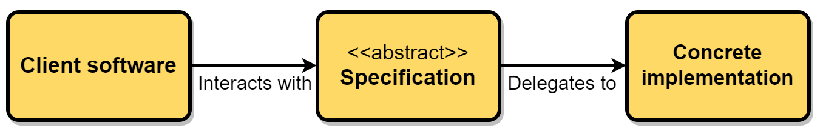
Requirements Specification-oriented approach
The whole user-driven modeling constraint framework consists of two parts:
Specification with a domain layer and a set of interfaces to be implemented by a concrete implementation
Concrete implementation that uses the specification as a dependency to implement the required functionality - mainly graph creation and constraint definition realized via mappers
Application that is willing to use the framework should include only the concrete implementation

Slide 17
Related work
Tool | T1 | T2 | T3 | T4 | T5 | Total
Gremlin | 1.0 | 1.0 | 1.0 | 0.5 | 1.0 | 4.5
Shacl | 1.0 | 1.0 | 1.0 | 0.5 | 0.5 | 4.0
Alloy | 0.5 | 1.0 | 1.0 | 1.0 | 0.0 | 3.5
GrGen | 1.0 | 0.5 | 1.0 | 1.0 | 0.0 | 3.5
Viatra | 1.0 | 0.5 | 0.0 | 1.0 | 0.5 | 3.0
OCL | 1.0 | 0.5 | 0.5 | 0.5 | 0.5 | 3.0
MetaDepth | 1.0 | 0.5 | 0.5 | 0.5 | 0.0 | 2.5
GraphFrames | 1.0 | 0.0 | 0.0 | 1.0 | 0.5 | 2.5
Melanee | 1.0 | 0.5 | 0.0 | 1.0 | 0.0 | 2.5
T1 – language expressiveness
T2 – dynamic extendibility
T3 – a standalone tool with no inter-dependencies
T4 – performance
T5 – low-entry level and being well-documented

Slide 18
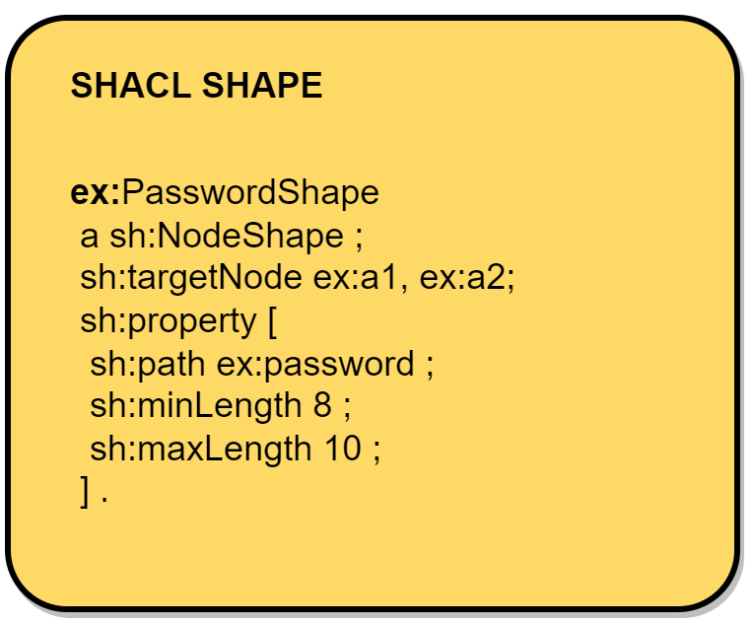
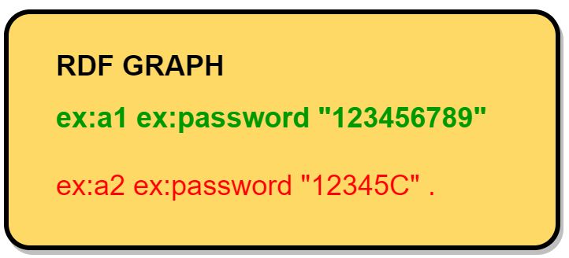
Related work SHACL

Slide 19
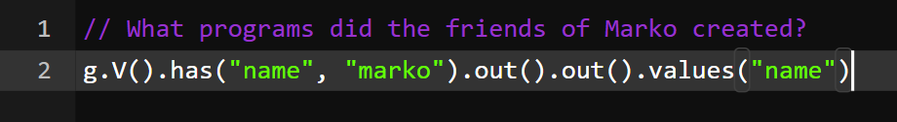
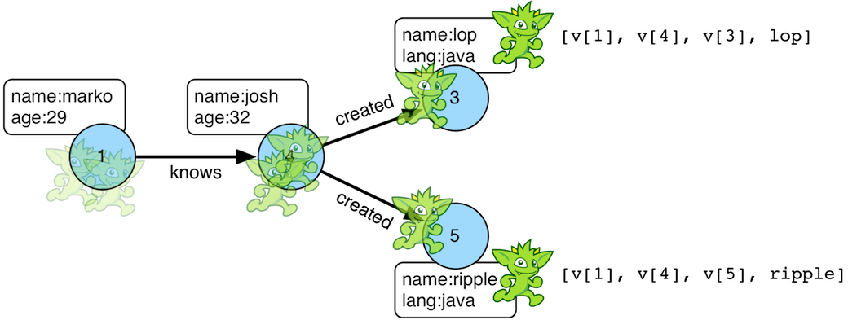
Related work Gremlin

Slide 20
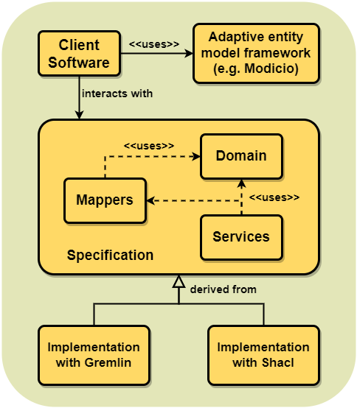
Solution concept Top-level architecture
Client software must support adaptive entity models at runtime
Client software interacts only via specification endpoints
Any concrete implementation must be derived from the specification

Slide 21
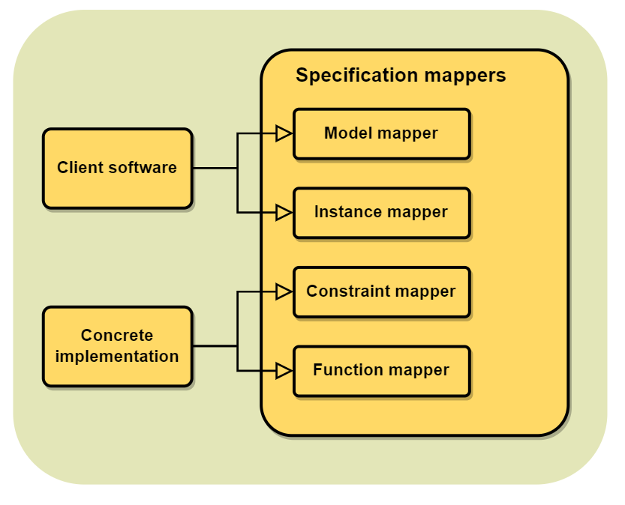
Solution concept Specification mappers
The specification module exposes a set of mappers needed to link technical spaces.
Client software must implement model and instance mappers
Constraint implementation must implement constraint and function mappers

Slide 22
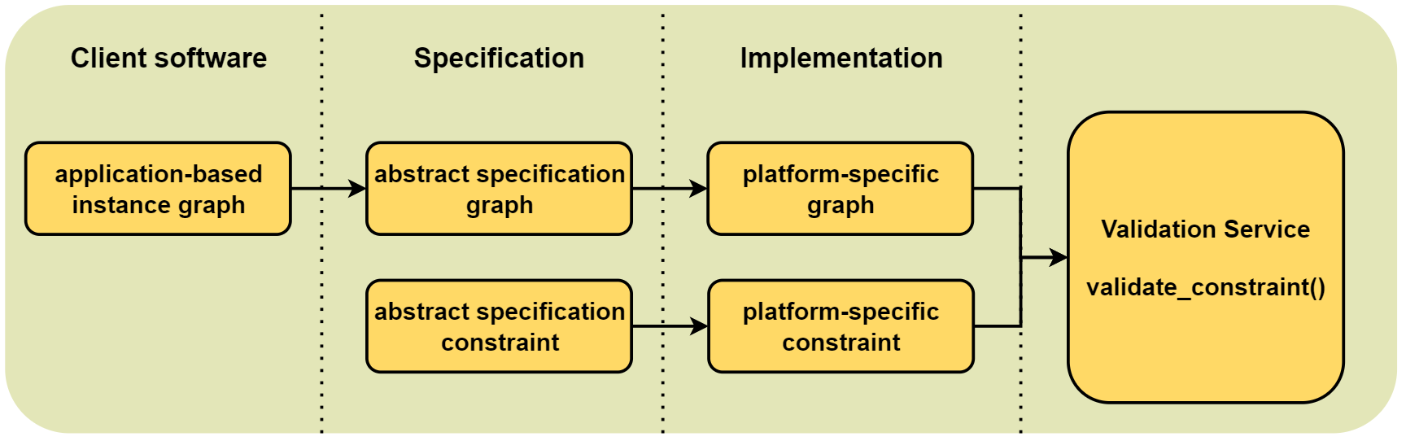
Solution concept Dataflow
Data conversion stays transparent to an end-user
Data format mapping happens in the background before validating constraints

Slide 23
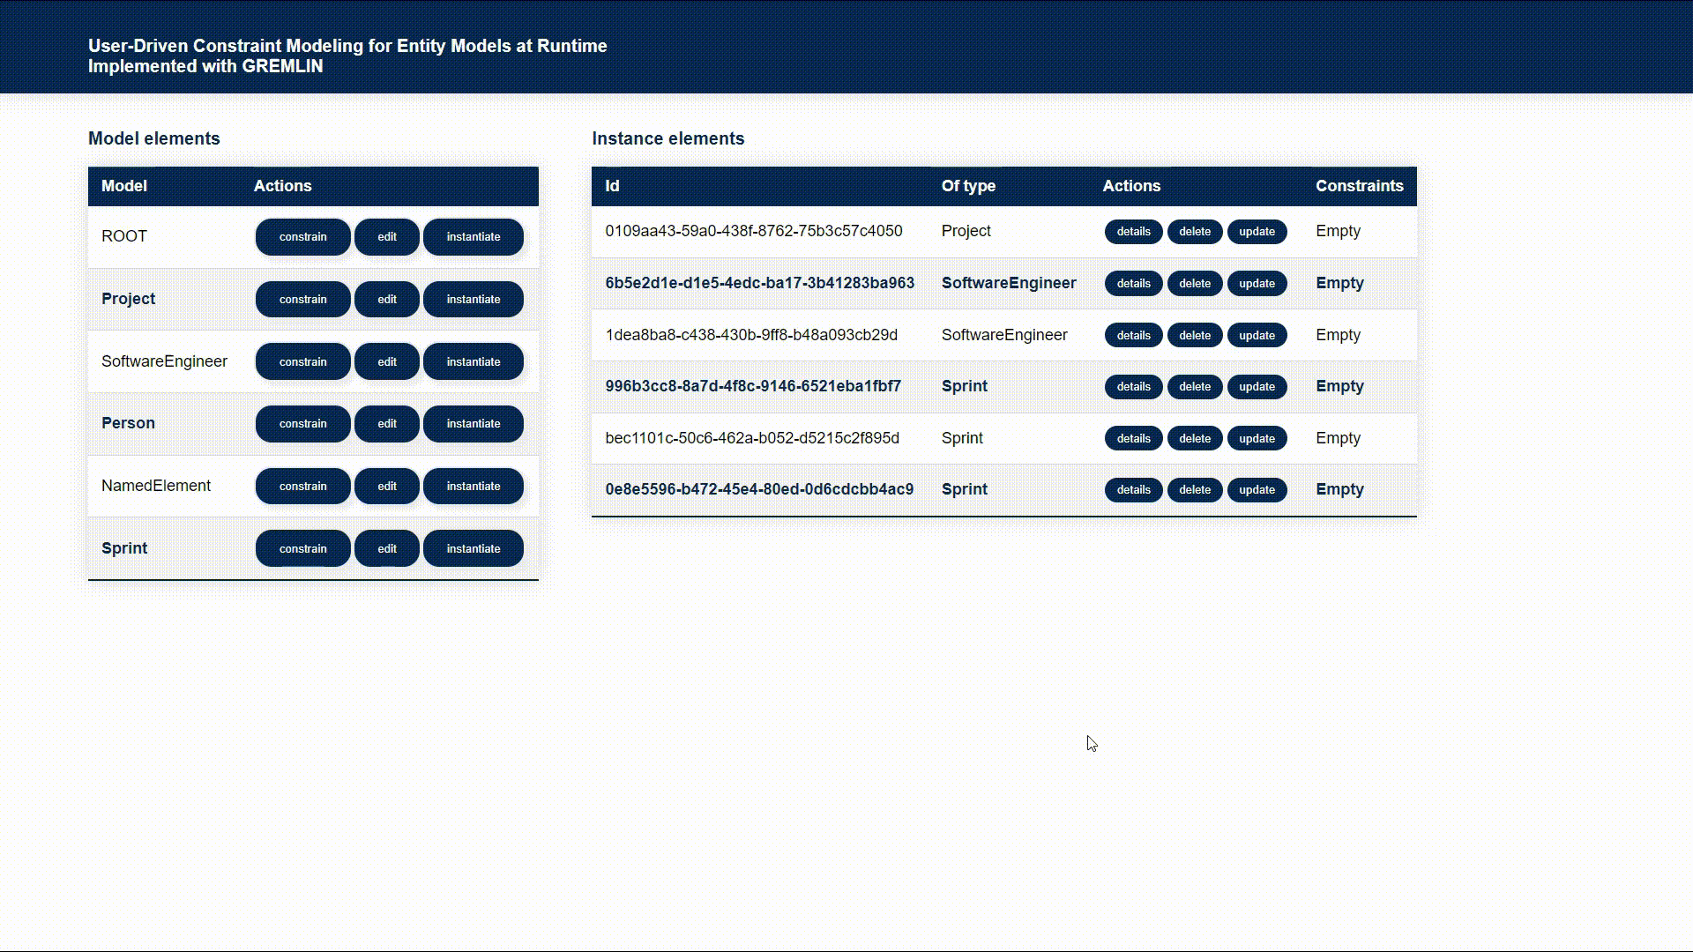
Implementation Constraint definition by example

Slide 24
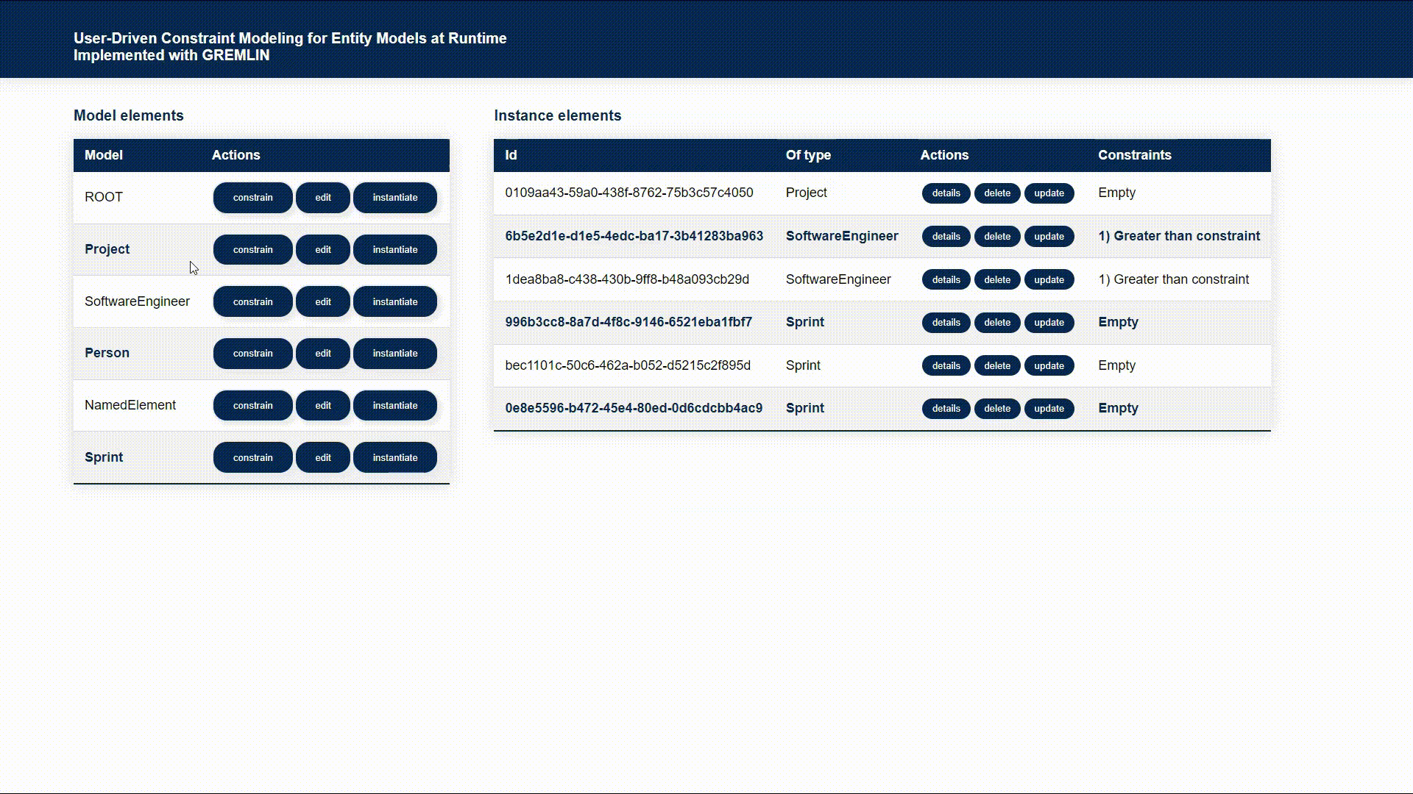
Implementation Constraint validation by example

Slide 25

Implementation Complex case constraint

Slide 26
Evaluation and case study
What is better? Gremlin or Shacl?

Slide 27
Evaluation and case study Tool expressiveness
In the scope of implemented constraints, it was discovered:
All constraint types could be successfully expressed using Gremlin
The following constraints could not be defined using Shacl:
Unique() – attribute value must be unique
ForAll() – for every instance in a collection, check a constraint
IfThen() – if a condition is true, check a constraint
IfThenElse() – if a condition is true, check constraint A, otherwise B

Slide 28
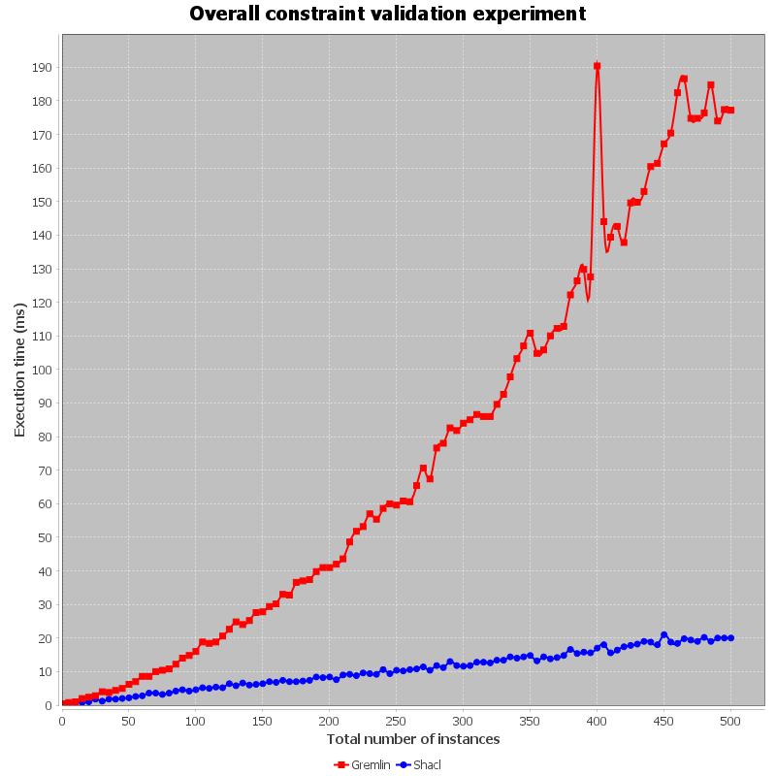
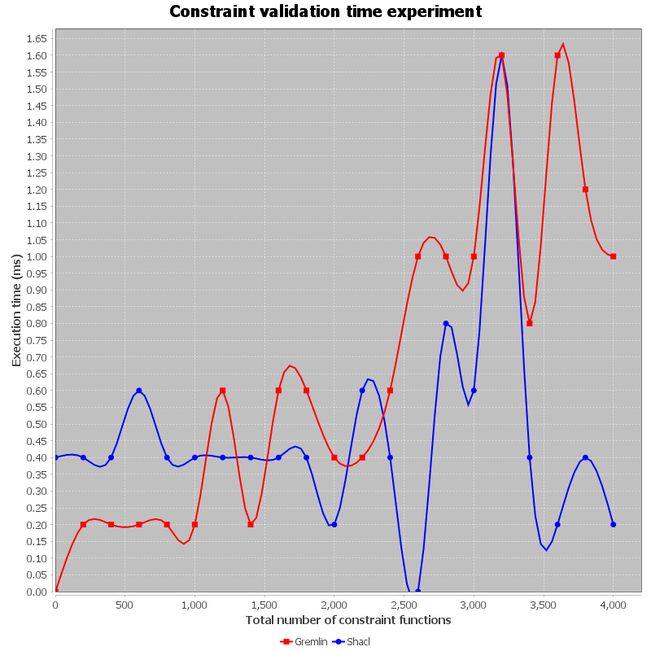
Evaluation and case study Performance
Shacl surpasses Gremlin in terms of performance by a factor of 8
The bottleneck of Gremlin is the initial construction of a traversal source and traversal steps
Constraint validation time is nearly equal
Gremlin
Shacl

Slide 29


Evaluation Recommendations
What is your priority? Tool expressiveness or performance?
If favor expressiveness, then Gremlin is a better choice
If performance is needed, then Shacl is a much more reasonable choice
…in addition:
Both Shacl and Gremlin support mechanisms to dynamically create and execute new constraint types
Gremlin has more comprehensive documentation and rich community support.
VS

Slide 30

Conclusion Future work
Complete the domain layer of the specification module
Design a graphical user interface to define constraints
Optimize performance for mapping technical spaces and constraint evaluation

Slide 31
Thank you very much for your attention!

